Slide 1

Web Page Designing- HTML, CSS and XML
By Prof Vaibhavi Patel

Slide 2
Content
HTML:HTML elements, Attributes, HTML Formatting list, table, images, iframe ,forms, HTML Classes, ID, HTML Links, HTML Graphics, HTML Media.
CSS: Types of CSS, Color, Background, Border, List, Tables, CSS Pseudo Classes, CSS Border Image, CSS Box Model, CSS Text Effects, CSS 2D Transforms, CSS 3D Transforms, CSS Animation, CSS User Interface.
XML: Introduction to XML, XML Tree, XML DTD, XML Schema.

Slide 3
CSS

Slide 4
Introduction
CSS stands for Cascading Style Sheets.
CSS describes how HTML elements are to be displayed on screen
CSS saves a lot of work. It can control the layout of multiple web pages all at once.
CSS is used to define styles for your web pages. Handles the presentation of the web page.

Slide 5
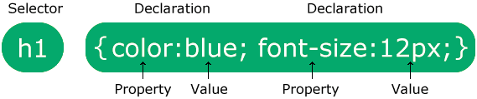
CSS Syntax
The selector points to the HTML element you want to style.
The declaration block contains one or more declarations separated by semicolons.
Each declaration includes a CSS property name and a value, separated by a colon.
Multiple CSS declarations are separated with semicolons, and declaration blocks are surrounded by curly braces.

Slide 6
CSS Selectors
The CSS element Selector
p { text-align: center; color: red; }
The CSS id Selector
#para1 { text-align: center; color: red; }
The CSS class Selector
.center { text-align: center; color: red; }

Slide 7
The id Attribute
: To define a specific style for one special element
<!DOCTYPE html>
<html>
<head>
<style>
#p01 {
color: blue;
}
</style>
</head>
<body>
<p id="p01">I am different.</p>
</body>
</html>
The id of an element should be unique within a page, so the id selector is used to select one unique element!

Slide 8
The class Attribute
: To define a style for special types of elements.
<!DOCTYPE html>
<html>
<head>
<style>
.error {
color: red;
}
</style>
</head>
<body>
<p class="error">I am different.</p>
<p class="error">I am different too.</p>
</body>
</html>
Notes:
You can add more than one class in same html element.
But you can not add more than one id in same element.

Slide 9
CSS can be added to HTML elements in 3 ways:
Inline - by using the style attribute in HTML elements
Internal - by using a <style> element in the <head> section
External - by using an external CSS file

Slide 10
Inline
An inline CSS is used to apply a unique style to a single HTML element.
An inline CSS uses the style attribute of an HTML element.
This example sets the text color of the <h1> element to blue:
<h1 style="color:blue;">This is a Blue Heading</h1>

Slide 11
Internal CSS
An internal CSS is used to define a style for a single HTML page.
An internal CSS is defined in the <head> section of an HTML page, within a <style> element:

Slide 12
Example of internal css
<!DOCTYPE html> <html> <head> <style> body {background-color: blue;} h1 , P {color: blue;} </style> </head> <body> <h1>This is a heading</h1> <p>This is a paragraph.</p> </body> </html>

Slide 13
External CSS
An external style sheet is used to define the style for many HTML pages.
With an external style sheet, you can change the look of an entire web site, by changing one file!
To use an external style sheet, add a link to it in the <head> section of the HTML page:

Slide 14
<!DOCTYPE html> <html> <head> <link rel="stylesheet" href="styles.css"> </head> <body> <h1>This is a heading</h1> <p>This is a paragraph.</p> </body> </html>
An external style sheet can be written in any text editor. The file must not contain any HTML code, and must be saved with a .css extension.
CSS file:
body { background-color: blue; } h1 { color: blue; } p { color: red; }

Slide 15
Cascading Order
What style will be used when there is more than one style specified for an HTML element?
Inline style (inside an HTML element)
External and internal style sheets (in the head section)
Browser default
where number one has the highest priority.
So, an inline style has the highest priority, and will override external and internal styles and browser defaults.

Slide 16
Comment
/* Write your comments here */

Slide 17
CSS Backgrounds
CSS Background Color
<h1 style="background-color:DodgerBlue;">Hello World</h1>
CSS background-image
body { background-image: url("paper.gif"); }
CSS background-repeat
values can be : repeat-x or repeat-y or no-repeat

Slide 18
CSS Backgrounds
CSS background-position Property
The background-position property sets the starting position of a background image.
Property Values
left top
left center
left bottom
right top
right center
right bottom
center top
center center
center bottom
Notes:
If you only specify one keyword, the other value will be "center"

Slide 19
CSS Backgrounds
CSS background-attachment
The background-attachment property specifies whether the background image should scroll or be fixed (will not scroll with the rest of the page):
body { background-image: url(“temp.png"); background-repeat: no-repeat; background-position: right top; background-attachment: fixed; }

Slide 20
CSS Backgrounds
CSS background-size Property
The background-size property specifies the size of the background images.
length Sets the width and height of the background image. The first value sets the width, the second value sets the height.

Slide 21
CSS Borders :
The CSS border properties allow you to specify the style, width, and color of an element's border.
CSS Border Style: The border-style property specifies what kind of border to display.
p.dotted {border-style: dotted;} p.dashed {border-style: dashed;} p.solid {border-style: solid;} p.double {border-style: double;}
CSS Border Width: The border-width property specifies the width of the four borders.
p{border-width: 5px;}
CSS Border Color: The border-color property is used to set the color of the four borders.
p{border-color: red;}
Notes:
border-collapse: collapse;

Slide 22
CSS Margins
The CSS margin properties are used to create space around elements, outside of any defined borders.
There are properties for setting the margin for each side of an element (top, right, bottom, and left).
margin-top
margin-right
margin-bottom
margin-left
Notes:
Margin - Shorthand Property: To shorten the code, it is possible to specify all the margin properties in one property.
The auto Value
You can set the margin property to auto to horizontally center the element within its container.

Slide 23
CSS Padding
Padding is used to create space around an element's content, inside of any defined borders.
There are properties for setting the padding for each side of an element (top, right, bottom, and left).
padding-top
padding-right
padding-bottom
padding-left
Notes:
Padding - Shorthand Property: To shorten the code, it is possible to specify all the Padding properties in one property.

Slide 24
CSS Height and Width
The CSS height and width properties are used to set the height and width of an element.
div { height: 200px; width: 50%;
}

Slide 25
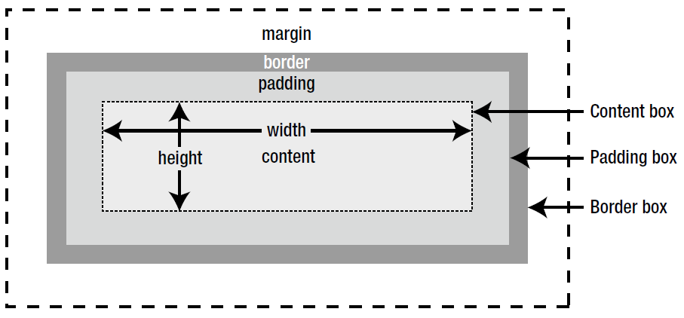
The CSS Box Model
It consists of: margins, borders, padding, and the actual content
Notes:
Content - The content of the box, where text and images appear
Padding - Clears an area around the content. The padding is transparent
Border - A border that goes around the padding and content
Margin - Clears an area outside the border. The margin is transparent
Important: When you set the width and height properties of an element with CSS, you just set the width and height of the content area. To calculate the full size of an element, you must also add padding, borders and margins.

Slide 26
CSS Text
Text Alignment: The text-align property is used to set the horizontal alignment of a text.
A text can be left or right aligned, centered, or justified.
h1 { text-align: center; }
Vertical Alignment: The vertical-align property sets the vertical alignment of an element.
p { vertical-align: baseline; /* text-top or sub or super or center */ }
Notes:
When the text-align property is set to "justify", each line is stretched so that every line has equal width, and the left and right margins are straight (like in magazines and newspapers)

Slide 27
CSS Text
Text Decoration: The text-decoration property is used to set or remove decorations from text.
h2 { text-decoration: overline; /* line-through or underline or none*/ }
Text Transformation: It is used to turn everything into uppercase or lowercase letters, or capitalize the first letter of each word.
p { text-transform: uppercase; /* lowercase or capitalize */ }
Notes:
The value text-decoration: none; is often used to remove underlines from links:
Note: It is not recommended to underline text that is not a link, as this often confuses the reader.

Slide 28
CSS Text
Text Indentation: is used to specify the indentation of the first line of a text.
p { text-indent: 50px; }
Letter Spacing: is used to specify the space between the characters in a text.
h1 { letter-spacing: 5px; }

Slide 29
CSS Text
Word Spacing is used to specify the space between the words in a text.
p { word-spacing: 10px; }
Line Height: is used to specify the space between lines.
p { line-height: 0.8; }

Slide 30
CSS Text
Text Color: The color property is used to set the color of the text.
h1 { color: green; }
Text Shadow: adds shadow to text.
h1 { text-shadow: 2px 2px; }
Notes:
h1 { text-shadow: 2px 2px 5px red; /*add a blur effect (5px) to the shadow, add a color (red) to the shadow */ }

Slide 31
CSS Box shadow
This property is used to apply shadow to elements.
div {
width: 300px;
height: 100px;
background-color: yellow;
box-shadow: 10px 10px;
}

Slide 32
CSS Fonts
The CSS font-family property defines the font to be used.
For more reference: https://developer.mozilla.org/en-US/docs/Web/CSS/font-family
The CSS font-size property defines the text size to be used.
p{ font-family: "Times New Roman“
}
h1 { font-size: 40px; }
Notes:
Choosing the right font for your website is important! Using a font that is easy to read is important.
Set Font Size With Em- 1em is 16px

Slide 33
CSS Fonts
The font-style property is mostly used to specify italic text.
The font-weight property specifies the weight of a font:.
p{ font-style: italic; or normal
}
h1 { font-weight: bold; or normal
}

Slide 34
CSS list
The list-style-type property specifies the type of list item marker.
ul { list-style-type: circle; or square or disc }
ul { list-style-image: url(‘image path'); }
Notes:
list-style-type: upper-roman or lower-alpha or decimal

Slide 35
CSS table
To specify table borders in CSS, use the border property.
The border-collapse property sets whether the table borders should be collapsed into a single border
table, th, td { border: 1px solid black; }
table { border-collapse: collapse; }

Slide 36
CSS Layout - The display Property
The display property specifies if/how an element is displayed.
The default display value for most elements is block or inline.
Block-level Elements
A block-level element always starts on a new line and takes up the full width available (stretches out to the left and right as far as it can).
Inline Elements
An inline element does not start on a new line and only takes up as much width as necessary.
Notes:
The display property is the most important CSS property for controlling layout.
Examples of block-level elements:<div> <h1> - <h6><p><form>
Examples of inline elements:<span><a><img>

Slide 37
CSS Layout - The display Property
Override The Default Display Value
Changing an inline element to a block element, or vice versa, display property is useful.
li { display: inline; }
Notes:
As mentioned, every element has a default display value. However, we can override this.

Slide 38
CSS Pseudo-classes
A pseudo-class is used to define a special state of an element.
For example, it can be used to:
Style an element when a user mouses over it
Style visited and unvisited links differently
Syntax
The syntax of pseudo-classes:
selector:pseudo-class { property: value; }

Slide 39
CSS Pseudo-classes: example with anchor
/* unvisited link */
a:link {
color: red;
}
/* visited link */
a:visited {
color: green;
}
/* mouse over link */
a:hover {
color: hotpink;
}
/* selected link */
a:active {
color: blue;
}

Slide 40
CSS :hover Selector
The :hover selector is used to select elements when you mouse over them.
p:hover, h1:hover, a:hover { background-color: yellow; }

Slide 41
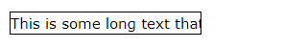
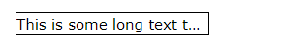
CSS Text Effects- CSS Text Overflow
Defines how the hidden text content behaves if it's overflowing.
text-overflow: clip; (default)
The text content is clipped and not accessible.
text-overflow: ellipsis;
The overflowing content is replaced by an ellipsis: (…)

Slide 42
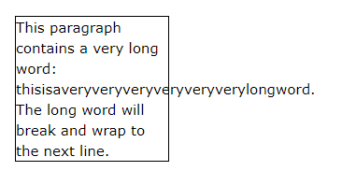
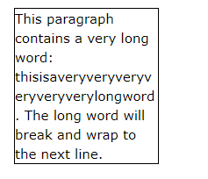
CSS Text Effects- Word Wrapping
The CSS word-wrap property allows long words to be able to be broken and wrap onto the next line.
p { word-wrap: break-word; }
If a word is too long to fit within an area, it expands outside:
The word-wrap property allows you to force the text to wrap.

Slide 43
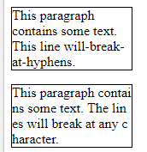
CSS Text Effects- word-break
The CSS word-break property specifies line breaking rules.
word-break: keep-all;
word-break: break-all;

Slide 44
CSS Text Effects- Writing Mode
The CSS writing-mode property specifies whether lines of text are laid out horizontally or vertically.
writing-mode: vertical-lr;
Text is read from left to right and top to bottom:
writing-mode: vertical-rl;
Text is read from right to left and top to bottom:
Notes:
writing-mode: horizontal-tb;
This is the default value of the property: text is read from left to right and top to bottom.

Slide 45
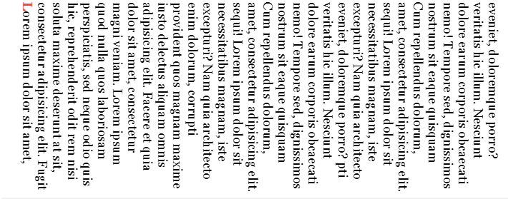
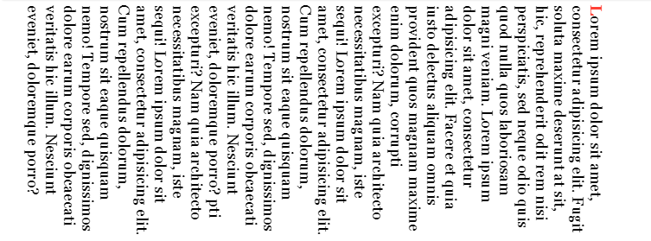
CSS Text Effects- Writing Mode
writing-mode: vertical-lr;
writing-mode: vertical-rl;

Slide 46
CSS 2D Transforms
CSS transforms allow you to translate, rotate, scale, and skew elements.
A transformation is an effect that lets an element change shape, size and position.
CSS supports 2D and 3D transformations.

Slide 47
CSS 2D Transforms
2D transformation methods:
translate()
rotate()
scale()
skewX()
skewY()

Slide 48
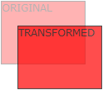

The translate() Method
The translate() method moves an element from its current position (according to the parameters given for the X-axis and the Y-axis).
The following example moves the <div> element 50 pixels to the right, and 100 pixels down from its current position
transform: translate(50px, 100px);

Slide 49

The rotate() Method
The rotate() method rotates an element clockwise or counter-clockwise according to a given degree.
The following example rotates the <div> element clockwise with 20 degrees:
transform: rotate(20deg);

Slide 50
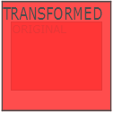
The scale() Method
The scale() method increases or decreases the size of an element (according to the parameters given for the width and height).
The following example increases the <div> element to be two times of its original width, and three times of its original height:
transform: scale(2,3);

Slide 51
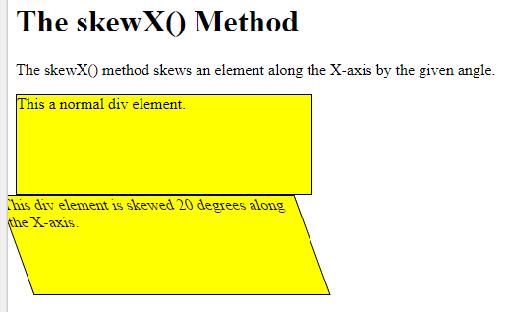
The skewX() Method
The skewX() method skews an element along the X-axis by the given angle.
The following example skews the <div> element 20 degrees along the X-axis:
transform: skewX(20deg);

Slide 52
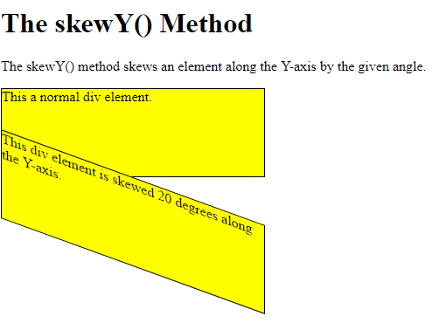
The skewY() Method
The skewY() method skews an element along the Y-axis by the given angle.
The following example skews the <div> element 20 degrees along the Y-axis:
transform: skewY(20deg);

Slide 53
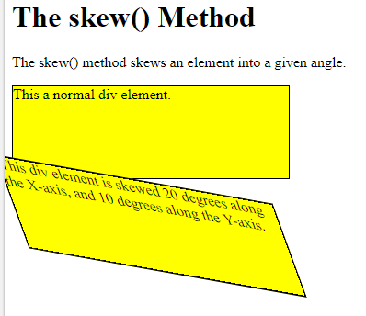
transform: skew(20deg,10deg);

Slide 54
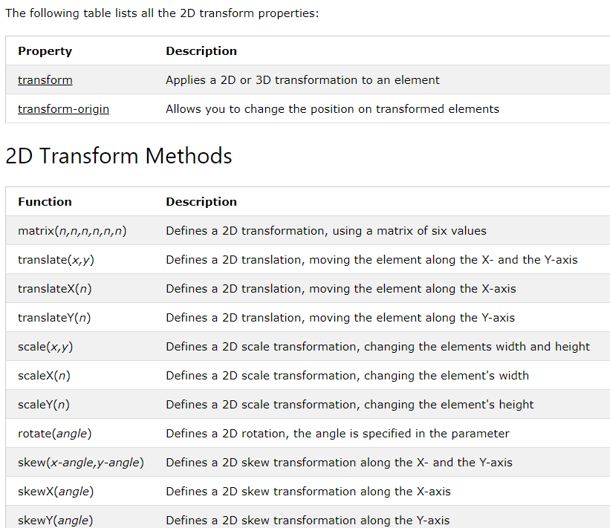

Slide 55
CSS 3D Transforms Methods
With the CSS transform property you can use the following 3D transformation methods:
rotateX() //rotates an element around its X-axis at a given degree
transform: rotateX(150deg);
rotateY() //rotates an element around its Y-axis at a given degree
transform: rotateY(150deg);
rotateZ() //rotates an element around its Z-axis at a given degree
transform: rotateZ(90deg);

Slide 56


Animation
CSS animations allows animation of most HTML elements without using JavaScript or Flash!
An animation lets an element gradually change from one style to another.
You can change as many CSS properties you want, as many times you want.
To use CSS animation, you must first specify some keyframes for the animation.
Keyframes hold what styles the element will have at certain times.

Slide 57
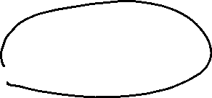
The @keyframes Rule
When you specify CSS styles inside the @keyframes rule, the animation will gradually change from the current style to the new style at certain times.
To get an animation to work, you must bind the animation to an element.

Slide 58





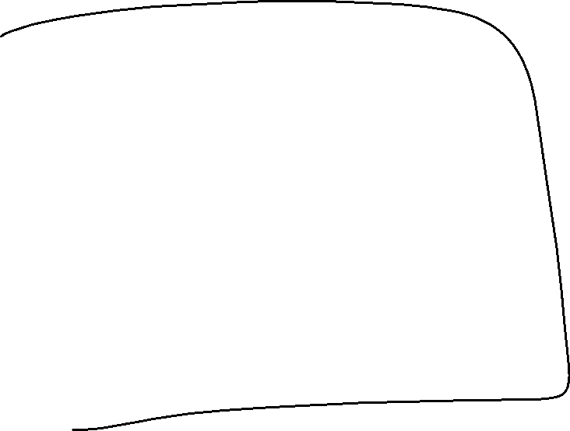


/* The animation code */ @keyframes example { from {background-color: red;} to {background-color: yellow;} } /* The element to apply the animation to */ div { width: 100px; height: 100px; background-color: red; animation-name: example; animation-duration: 4s; }

Slide 59
Code explanation
Note: The animation-duration property defines how long time an animation should take to complete.
If the animation-duration property is not specified, no animation will occur, because the default value is 0s (0 seconds).
In the example above we have specified when the style will change by using the keywords "from" and "to" (which represents 0% (start) and 100% (complete)).

Slide 60
It is also possible to use percent. By using percent, you can add as many style changes as you like.
/* The animation code */ @keyframes example { 0% {background-color: red;} 25% {background-color: yellow;} 50% {background-color: blue;} 100% {background-color: green;} } /* The element to apply the animation to */ div { width: 100px; height: 100px; background-color: red; animation-name: example; animation-duration: 4s; }
Notes:
The above example will change the background-color of the <div> element when the animation is 25% complete, 50% complete, and again when the animation is 100% complete:

Slide 61
Delay an Animation
The animation-delay property specifies a delay for the start of an animation.
Negative values are also allowed. If using negative values, the animation will start as if it had already been playing for N seconds.
div { animation-name: example; animation-duration: 4s; animation-delay: 2s; }

Slide 62
Set How Many Times an Animation Should Run
The animation-iteration-count property specifies the number of times an animation should run.
Notes:
uses the value "infinite" to make the animation continue for ever

Slide 63
CSS User Interface
CSS user interface property: resize
The resize property specifies if (and how) an element should be resizable by the user.
div { resize: horizontal; /* or vertical or both or none */
overflow: scroll; }

Slide 64
Thank You

